Slide 1
Job Postings
Characteristics of real vs. fake job listings
Sujay Chebbi | Alexandre Nicolai | Patricia Schutter | Kaiwen Zhang

Slide 2

Agenda
Project Goals
Exploratory Analysis
Analysis
Solution & Insights

Slide 3
Project Goals
Description
Based on job postings, try to determine the features that make a job posting fraudulent or non-fraudulent.
Importance
Optimize efficiency
Protect against job scams

Slide 4
Exploratory Analysis

Slide 5
Dataset
17,880 job postings with 18 features each
Job ID
Job title
Location
Department
Salary Range
Company Profile
Description
Requirements
Benefits
Telecommuting
Company Logo
Questions
Employment Type
Required Experience
Required Education
Industry
Function
Fraudulent

Slide 6
Dataset Challenges
Categorical Data
All 18 columns were categorical
4 columns were made up of sentences
Missing Data
Dataset included 70,103 missing values across all rows and columns

Slide 7
Analysis

Slide 8
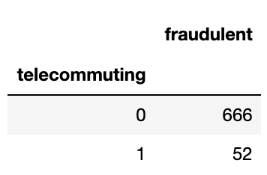
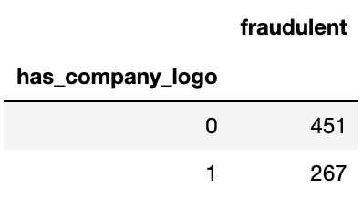
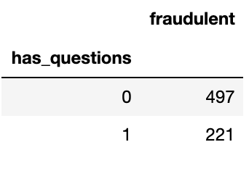
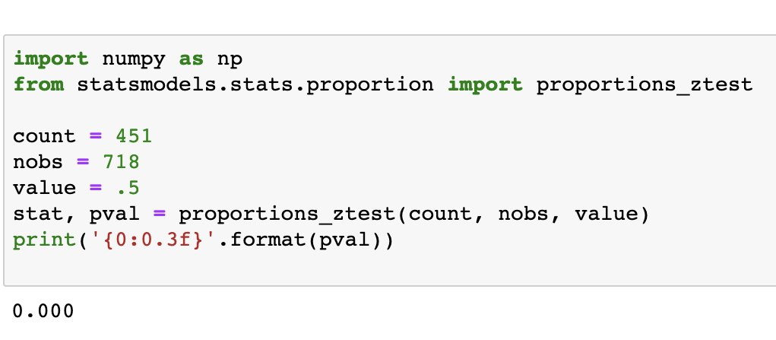
Important Dummy Variables
Statistically significant proportion z-test
P-values effectively 0
Pattern between fraudulence and these characteristics
Assumptions:
Random sample
Proportions normally distributed

Slide 9
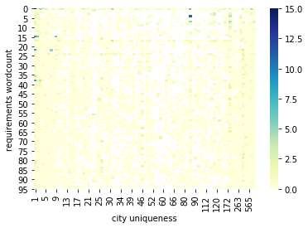
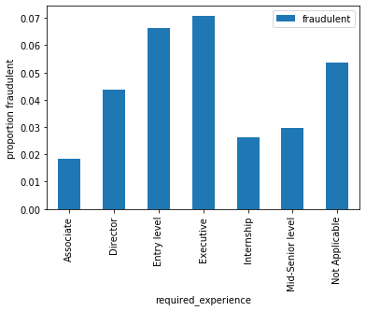
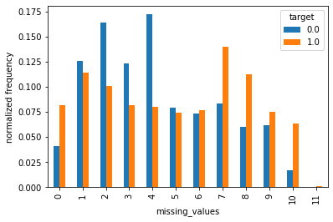
Preference for Extremes
Bogus/misspelled/unusual cities vs. big-market cities
“Too good to be true” vs. “too good to be true”
“Be super detailed” vs. “don’t try at all”

Slide 10
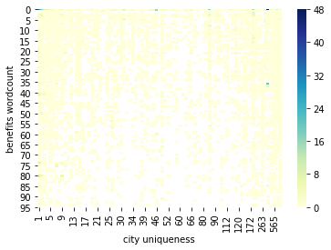
“Laziness” and word counts are good predictors

Slide 11
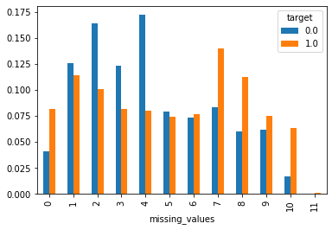
Missing Values

Slide 12
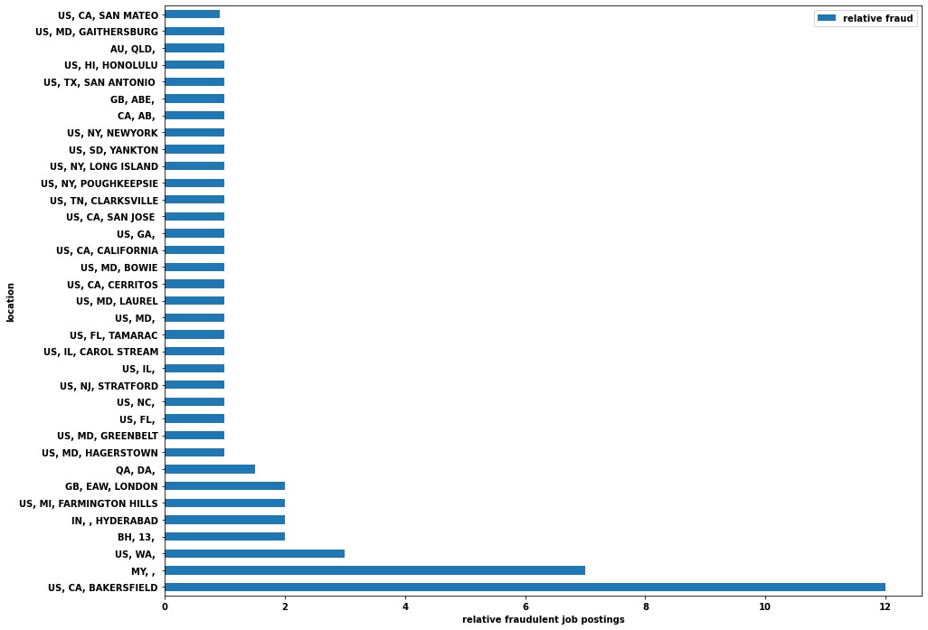
Determining relative fraudulent job postings by location
A list of cities with relative fraudulent job postings greater than or equal to 0.9, meaning that these cities are more likely to have fraudulent job postings

Slide 13
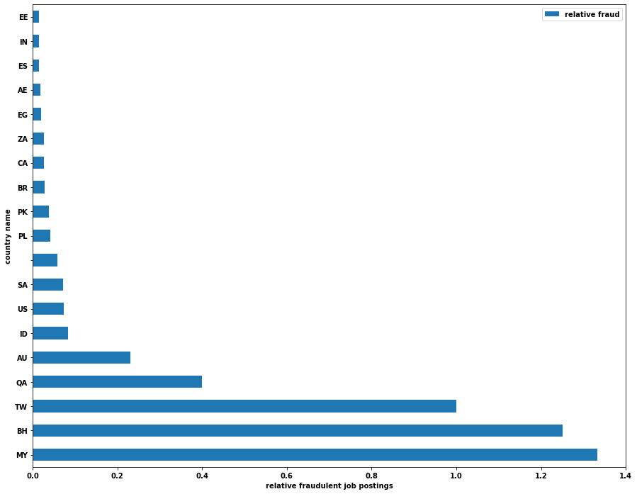
Determining relative fraudulent job postings by country
A list of countries with relative fraudulent job postings greater than or equal to 0.01, meaning that these countries are more likely to have fraudulent job postings

Slide 14
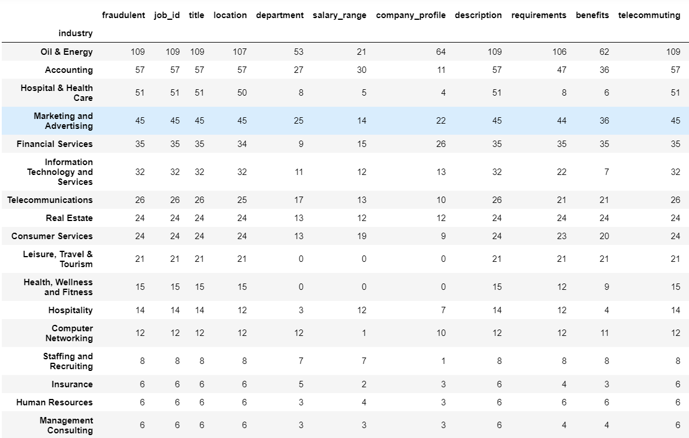

Slide 15
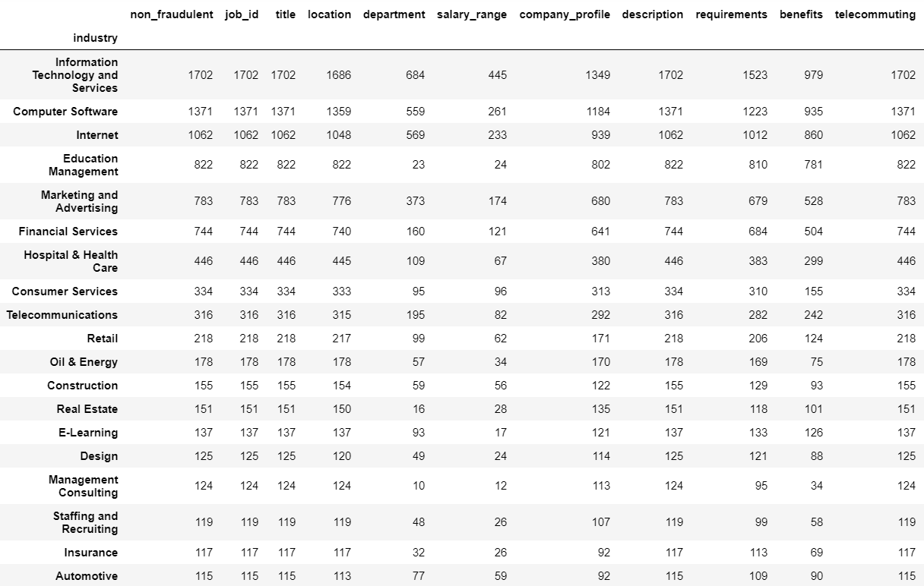

Slide 16
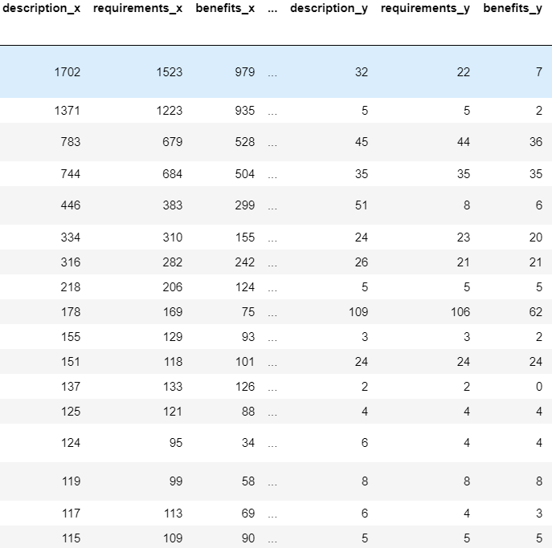
Result merging the two previous tables on their index (the sector).
X = Real job announces
Y = Fake Job announces

Slide 17
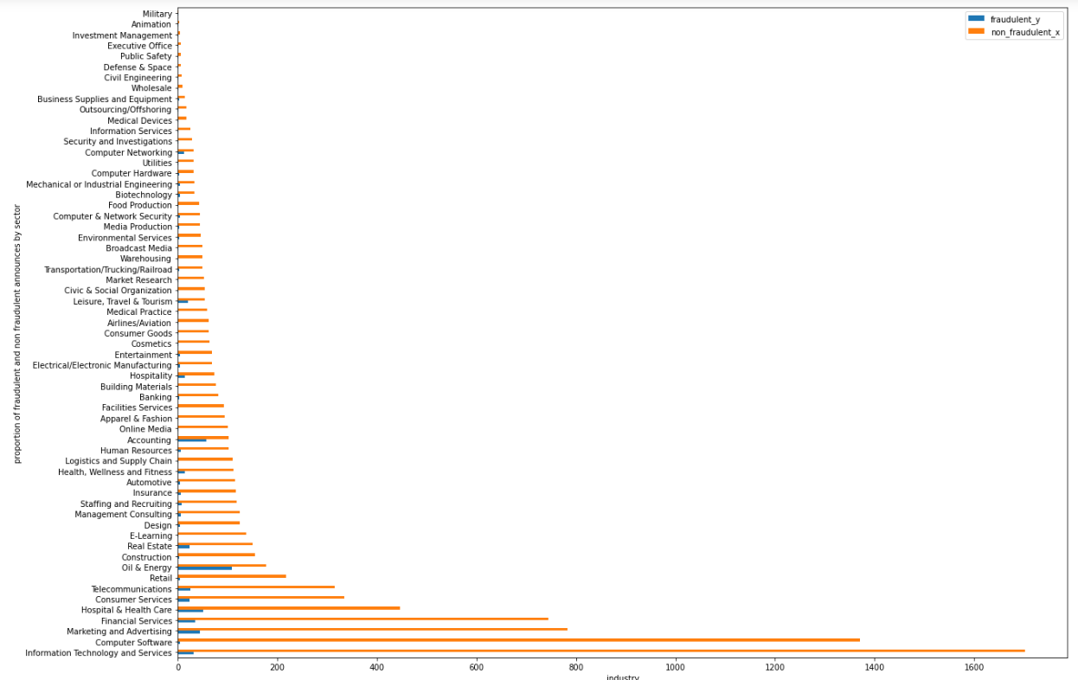
Proportion of fake jobs announces per sector in blue

Slide 18
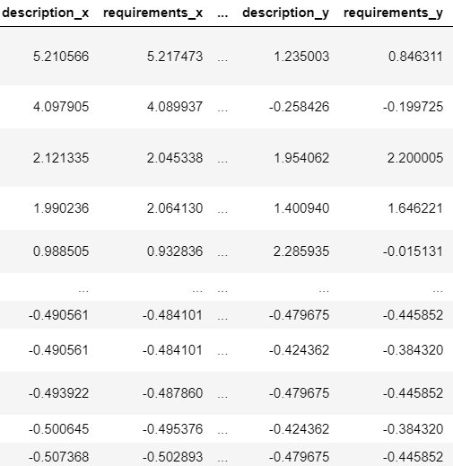
Table normalized using the Z-Score method.

Slide 19
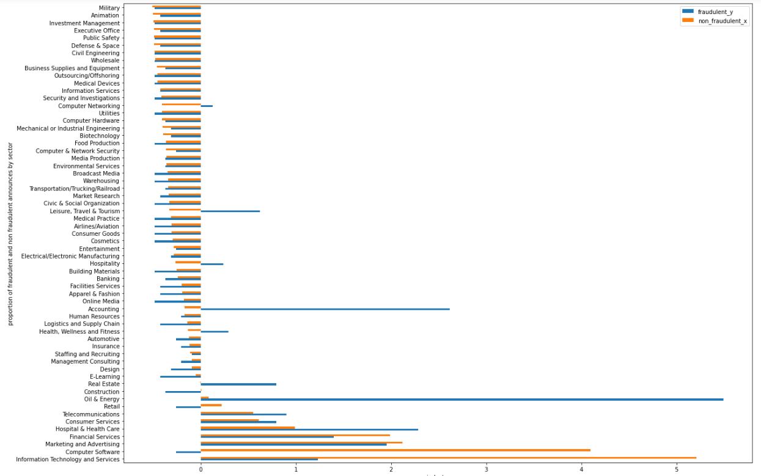
Proportion of fake jobs announces per sector in blue

Slide 20
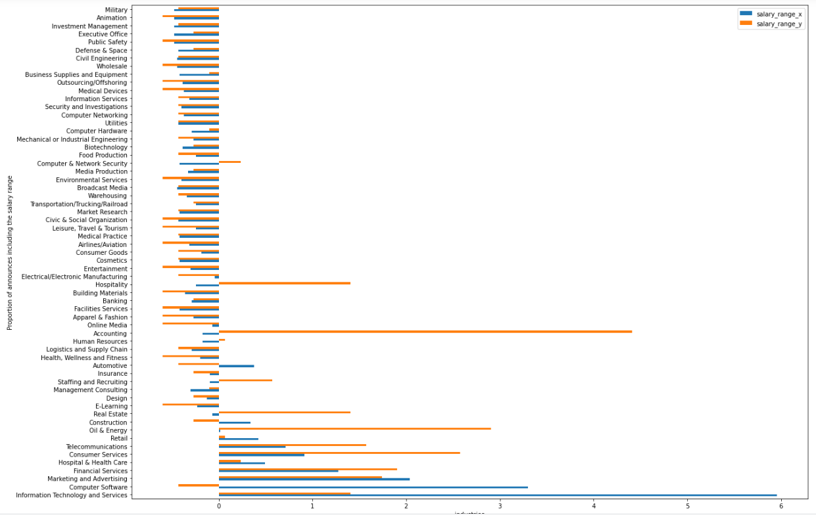
Proportion of fake jobs announces (in blue) showing the salary range (per sector).

Slide 21
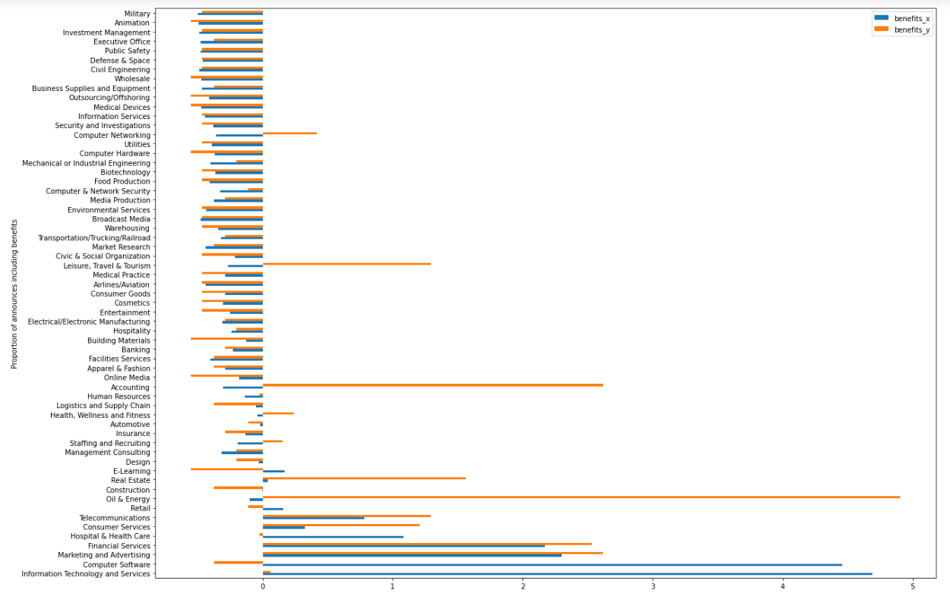
Proportion of fake jobs announces (in blue) showing the benefits (per sector).

Slide 22
Solution & Insights

Slide 23
Logistic Regression
FEATURE | IMPACT
Industry [Education Management] | -2.453213
Industry [Internet] | -2.186165
Function [ Health Care Provider] | -2.02904
Location [ Greece] | -1.956881
Salary Range [55,000-75,000] | -1.781989
Industry [Computer Software] | -1.661547
Industry [Restaurants] | -1.599323
Required Experience [Associate] | -1.581123
Location [Germany] | -1.489198
Industry [Insurance] | -1.44227
Department [Operations] | -1.427709
Location [Philippines] | -1.403489
Employment Type [Temporary] | -1.39878
Department [Oil and Gas] | -1.343899
Department [Legal] | -1.310619
Department [Marketing] | -1.302265
Required Experience [Executive] | -1.243289
Department [Department] | -1.208611
Has company Logo [True] | -1.205376
Salary Range [0-0] | -1.081002
Features of a legit posting:
Industry
Function
Location
Salary Range
Department
Employment type
Required Experience
Company Logo

Slide 24
Logistic Regression
FEATURE | IMPACT
Department [Oil & Energy] | 3.441561
Department [Information Technology] | 2.89915
Industry [Oil & Energy] | 2.886244
Department [Engineering] | 2.723301
Location [Malaysia] | 2.557432
Location [Australia] | 2.239522
Department [Call Center] | 2.218432
Department [Accounting/Payroll] | 2.20586
Salary Range [7200-1380000] | 2.190508
Industry [Leisure, Travel, & Tourism] | 2.147251
Industry [Computer Networking] | 2.102746
Salary Range [28000-32000] | 1.922421
Department [Clerical] | 1.914747
Department [CSR] | 1.863665
Department [Biotech] | 1.695124
Department [Power Plant & Energy] | 1.660967
Industry [Hospitality] | 1.645928
Title [12] | 1.644899
Department [Engineering] | 1.631634
Industry [Accounting] | 1.557629
Features of a fraudulent posting:
Department
Industry
Location
Salary Range
Title

Slide 25
Thank You

Slide 26
Appendix

Slide 27
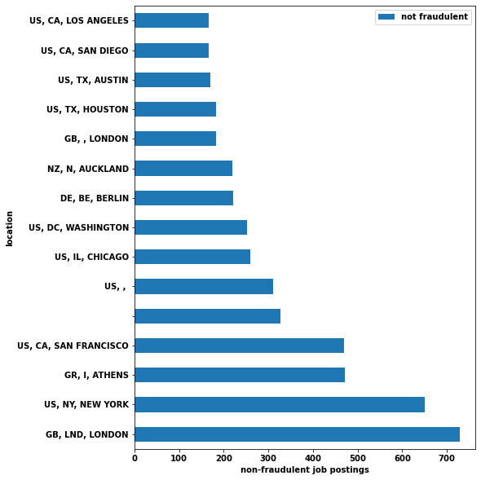
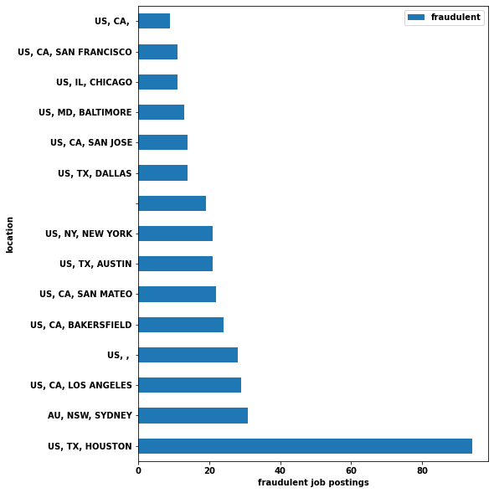
Determining fraudulent and legitimate job postings by location
Top 15 cities with most legitimate job postings
Top 15 cities with most fraudulent job postings

Slide 28
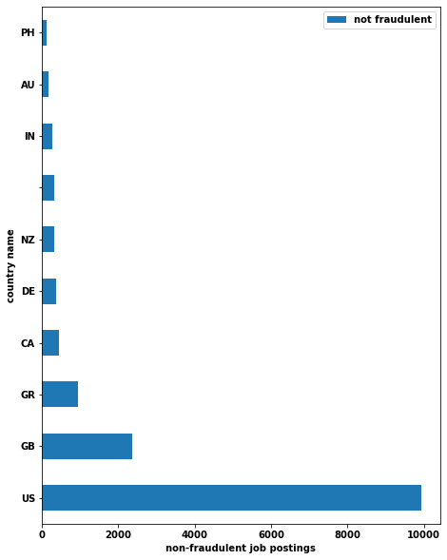
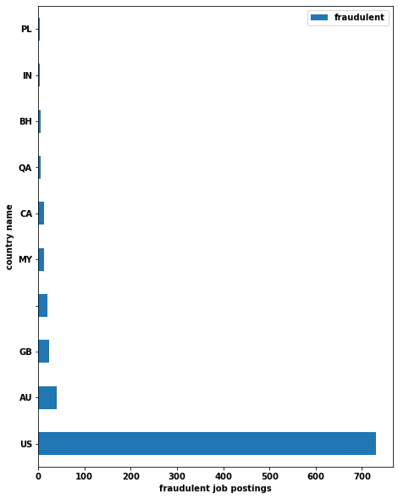
Determining fraudulent and legitimate job postings by country
Top 10 countries with most legitimate job postings
Top 10 countries with most fraudulent job postings

Slide 29
Missing Values By Feature
Feature | Amount
Title | 0
Location | 0
Department | 11547
Salary Range | 15012
Company Profile | 3353
Description | 13
Requirements | 7326
Benefits | 7326
Telecommuting | 0
Feature | Amount
Company Logo | 0
Questions | 0
Employment Type | 3471
Required Experience | 7050
Required Education | 8105
Industry | 4903
Function | 6455
Fraudulent | 0

Slide 30
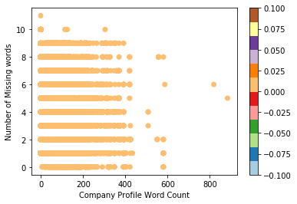
KNN

Slide 31
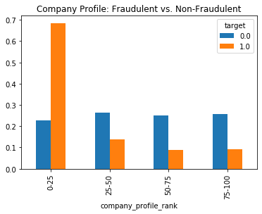
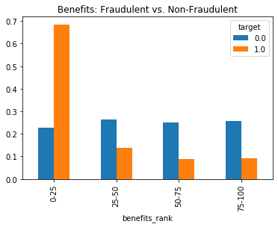
Notes:
Company Profile:
# 0-25: -1-21
# 25-50: 21-83
# 50-75: 83-132
# 75-100: 132-884
Benefits:
# 0-25 = -1
# 25-50 = -1 - 6
# 50-75 = 6-41
# 75-100 = 41-678

